Slide 1
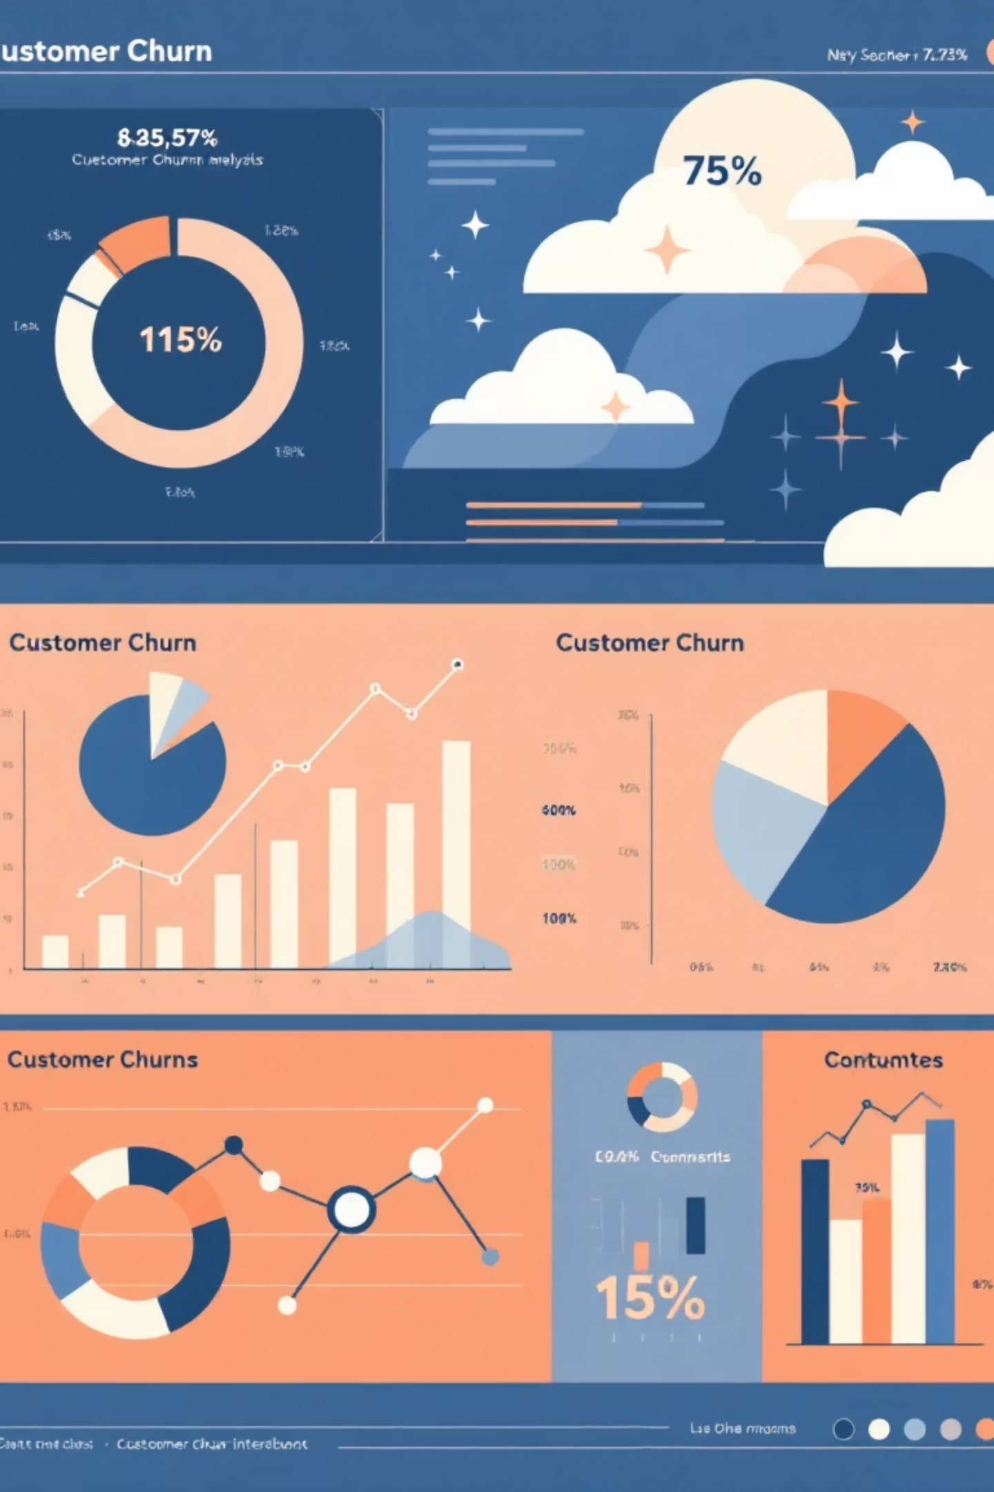
EDA ON TELCO DATASET
Identifying key factors affecting customer retention to improve loyalty.

Slide 2

What is Exploratory Data Analysis (EDA)?
Exploratory Data Analysis (EDA) is the process of examining and understanding data sets to summarize their main characteristics, often using visual and statistical methods. It is a crucial first step in any data analysis or machine learning project, as it helps analysts and data scientists uncover patterns, detect anomalies, test hypotheses, and check assumptions before applying advanced modeling techniques.
Professionally speaking, EDA serves as the foundation for informed decision-making in data-driven projects. It involves techniques such as data cleaning, descriptive statistics, and visualization (like histograms, scatter plots, and box plots) to explore relationships and trends within the data.

Slide 3



Python Libraries for Analysis
Pandas
Data manipulation and analysis.
NumPy
Numerical computing with arrays.
Matplotlib
Creating static, interactive, and animated visualizations.
Seaborn
High-level interface for drawing attractive statistical graphics.

Slide 4
start project
WORK FLOW
Conclusion & Report
Insights Identification
- Early-tenure customers churn more
- Electronic check users churn more
- Month-to-Month contract has high churn
- Missing online services increase churn
- Senior citizens have higher churn rate
Import libraries
Load Dataset (DF)
Exploratory Data Analysis (EDA)
- Churn vs Tenure
- Senior Citizen vs Churn
- Payment Method vs Churn
- Contract Type vs Churn
- Services (Internet, Phone , Tech Support)
Data Cleaning / Prep
- Convert data type
- Handel missing values
– Encode categories

Slide 5

Data Preprocessing Steps
01
Load Data
Import raw customer churn dataset.
02
Handle Missing Values
Identify and address any incomplete data points.
03
Feature Engineering
Create new features or transform existing ones for better insights.
04
Encode Categorical Data
Convert non-numeric data into a suitable format for modeling.

Slide 6

Key Churn Factors Identified
Our analysis revealed several critical factors contributing to customer churn.
Contract Type
Payment Method
Higher churn among month-to-month users.
Electronic check payers show increased churn rates.
Service Absence
Demographics
Customers without online security or tech support churn more.
senior citizens show higher churn rate then younger customer

Slide 7
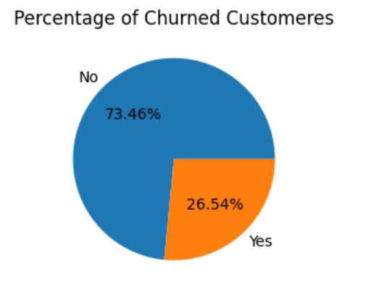
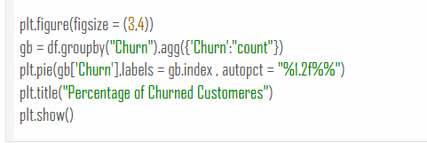
Total churned coustomer

Slide 8
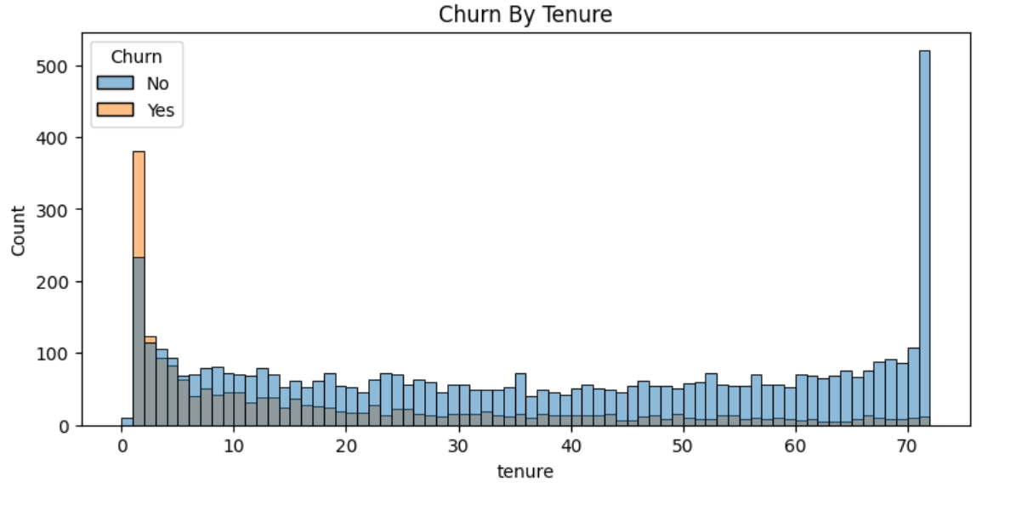
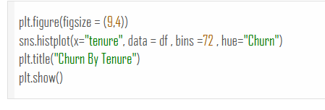
Churn Distribution by tenure

Slide 9
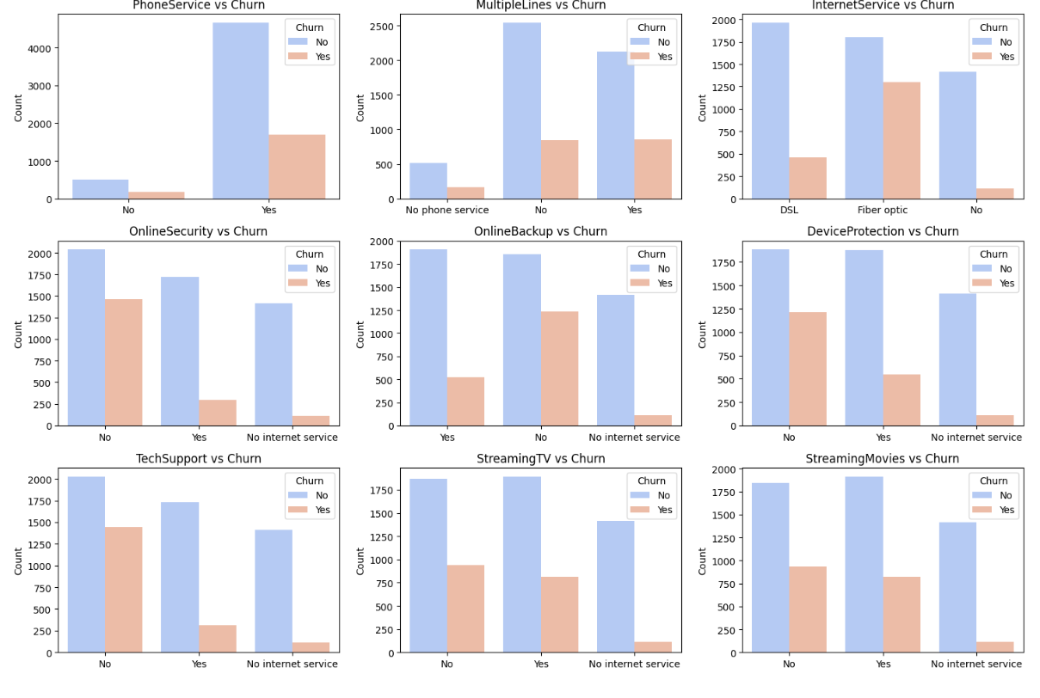

All services vs churn graph

Slide 10
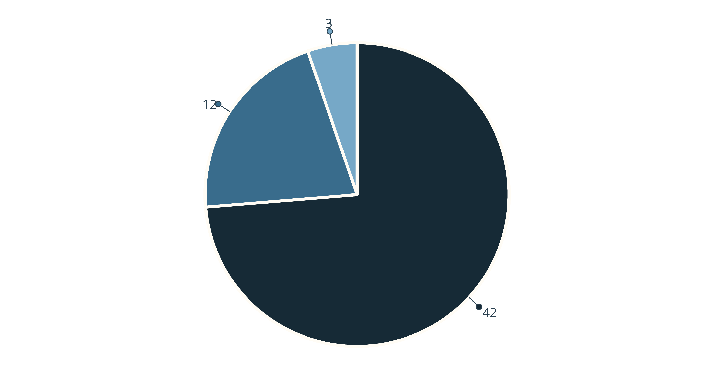
Churn Distribution by Contract Type
- The largest slice (42) represents Month‑to‑month contracts, indicating that customers on monthly plans have a significantly higher churn rate compared to the other contract types.
The second slice (12) is for One‑year contracts, showing a moderate level of churn.-
The smallest slice (3) belongs to Two‑year contracts, meaning very few customers with long‑term agreements churn . In short, the chart highlights that month‑to‑month subscribers are much more likely to leave (churn) than customers on yearly contracts, suggesting that longer contract commitments reduce churn.
Month-to-month
One year
Two year
The pie chart illustrates that month-to-month contracts have a significantly higher churn rate.

Slide 11
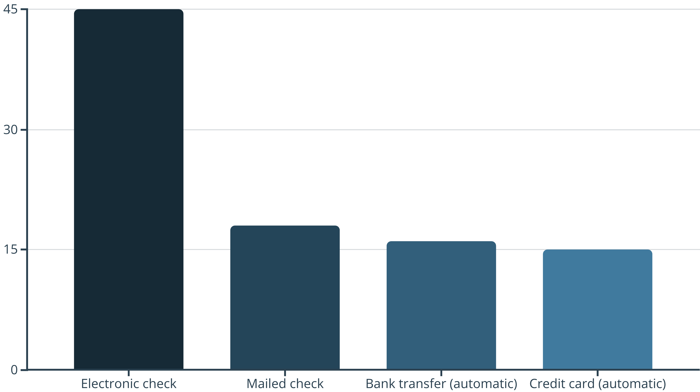
Payment Method Impact on Churn
Electronic checks are associated with the highest churn rates, indicating a potential area for intervention.

Slide 12

Service Offerings and Churn
Customers lacking essential services are more likely to churn. This highlights the importance of comprehensive service packages.
No Online Security
1) Customers without online security features (e.g., antivirus, firewall, VPN) feel vulnerable to threats.
2) This lack likely makes them perceive the service as incomplete or unsafe, pushing them to switch providers that offer robust security.
No Tech Support
1) Absence of technical support (phone, chat, or on‑site help) leaves customers stranded when issues arise.
2) The frustration of unresolved problems often leads to dissatisfaction and churn, especially for users who need quick assistance.
No Device Protection
1) Without device protection (insurance, repair services, or replacement plans), customers fear damage or loss of their devices. -
2) This gap makes the service seem less valuable, prompting them to move to competitors that provide comprehensive device safeguards

Slide 13




Actionable Insights for Retention
Promote Long-Term Contracts
Incentivize customers to switch from month-to-month plans.
Diversify Payment Options
Encourage automatic payment methods over electronic checks.
Enhance Service Bundles
Offer compelling packages including online security and tech support.

Slide 14

Conclusion: Improving Customer Loyalty
Overall approximately 26.7% of customers churned , highlighting a significant portion of customer discontinuing services . By understanding and addressing the key churn factors, businesses can significantly reduce customer attrition and foster stronger, more loyal customer relationships.

